Slide 1

HPCL-Content Management System and User Management System
Team However Part 2 Section A/B:
Grace Burton, Daniel Weitman, Billy Wolf, Alex English, Ian Thomas, Michael Mandulak

Slide 2
Team Structure
Class Meeting: MW 3:00-4:15pm
Group Meeting: MW 4:15-5:15pm
Extra Meeting: Th 3:00-5:00pm
Leader: Michael Mandulak
Client: Richard Quackenbush
CMS Pair: Grace Burton/Alex English
CMS implementation
UMS Pair A: Michael Mandulak/Daniel Weitman
UMS Back-end implementation
UMS Pair B: Ian Thomas/Billy Wolf
UMS Front-end implementation

Slide 3
CMS Recap
Postgres Database Design
Users
Blogs
Tickets
Groups
Users
Blogs
Permissions
Associated Technologies
Migration Scripts
RESTful API
HTTP Requests
Basic web pages demonstrating the back-end database
Designed in HTML, CSS
Populated via EJS Templating
Static routing and route Controller
Associated Technologies
Fetch (HTTP Requests)
EJS (Webpage Templating)
HTML, CSS, JS

Slide 4
CMS Goals
Ticketing system
Support tickets for administrators to view, edit, and send to other admins.
User authentication system

Slide 5
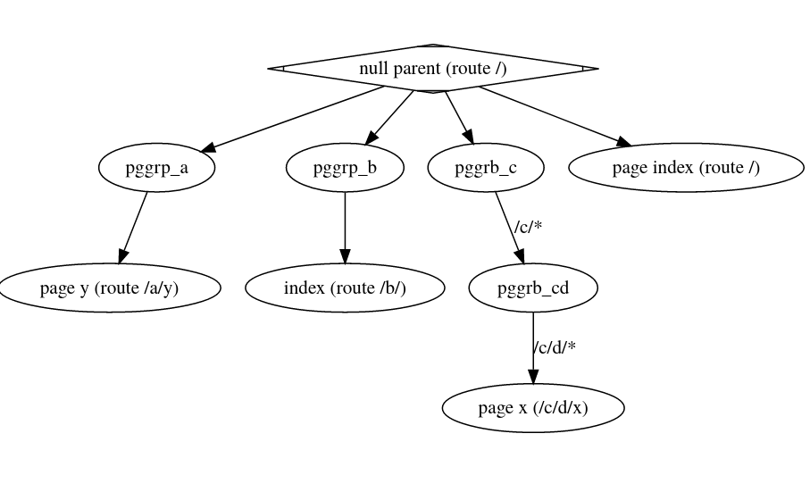
September Plan - CMS
Grace
Move from static to dynamic routing, based on database “tree"
Alex
Complete REST API Queries - The more we complete, the smoother we run

Slide 6
UMS Recap
Developed test and development environment using Docker (LDAP and Node)
Implemented back-end for user creation and modification (Typescript User class)
Incorporated some error handling and user data validation (passwords, groups, etc.)
Implemented a front-end to provide simple interaction with the LDAP database through the User class
Created a functional skeleton UMS web application

Slide 7
UMS Goals
Billy and Ian
Aesthetically redesign the website (responsive web design)
Password encryption and reset through email
Michael and Dan
User delete functionality (Typescript)
Group class (Typescript)
Home directory creation (PASETO & Python)

Slide 8
UMS Goals (cont.)
End product
System where administrators can add/modify/delete users
Users have ability to update password (without administrator)
Process new home directory requests through a queue
Responsive web design for user interaction
Organize and document code
Integrate with CMS

Slide 9
September Plan - UMS
Password encryption and password reset functionality (Currently working)
Rework website to fit new user data (including passwords)
User delete functionality (Currently Working)
Group class modeled after User class (Currently Working)
Home directory creation (End of September)

Slide 10
Q&A

